Slide 1
GEMP ACCESS COURSE: BIOLOGICAL CHEMISTRY
Lecturer: Christopher Larbie, PhD
Lecture 1:
Origin of Life and Biological Concepts

Slide 2
OBJECTIVES
In this lecture, the following would be learnt:
Definition of Life
Life is not possible on all planets.
An account of the various ideas about the origin of life.
The simplest structure within which life is invested is a cell with a well deﬁned boundary

Slide 3
Various views on origin of life
Life is a process which is capable of self-sustenance, replication and mutation.
Self-sustenance ensures that some damage or loss of material may occur, and these have to be made up for.
Replication is to ensure the continuity of life so that it does not become extinct.
Mutation permits the emerging progeny to change under the pressure of natural selection in order to compete efficiently for matter and energy in an increasingly changing environment.

Slide 4
Life is a characteristic distinguishing physical entities having biological processes, such as signalling and self-sustaining processes, from those that do not, either because such functions have ceased, or because they never had such functions and are classified as inanimate.
Various forms of life exist such as plants, animals, fungi, protists, archaea, and bacteria.
Other definition is
“Organisms maintain homeostasis, are composed of cells, undergo metabolism, can grow, adapt to their environment, respond to stimuli, and reproduce (MRS GREN; 7 life processes).

Slide 5
Life as living System
Living systems are open self-organizing living things that interact with their environment.
These systems are maintained by flows of information, energy and matter.
Some scientists have proposed in the last few decades that a general living systems theory is required to explain the nature of life.
Such a general theory, arising out of the ecological and biological sciences, attempts to map general principles for how all living systems work.

Slide 6
Gaia hypothesis
Gaia hypothesis, also known as Gaia theory or Gaia principle (developed by James Lovelock), proposes that organisms interact with their inorganic surroundings on Earth to form a synergistic self-regulating, complex system that helps to maintain and perpetuate the conditions for life on the planet.
Topics of interest include how the biosphere and the evolution of life forms affect the stability of global temperature, ocean salinity, oxygen in the atmosphere, the maintenance of a hydrosphere of liquid water and other environmental variables that affect the habitability of Earth.

Slide 7
Life as a Complex System
Complex systems biology (CSB) is a branch or subfield of mathematical and theoretical biology concerned with complexity of both structure and function in biological organisms, as well as the emergence and evolution of organisms and species, with emphasis being placed on the complex interactions of, and within, bionetworks, and on the fundamental relations and relational patterns that are essential to life.
CSB is thus a field of theoretical sciences aimed at discovering and modelling the relational patterns essential to life that has only a partial overlap with complex systems theory, and also with the systems approach to biology called systems biology;
this is because the latter is restricted primarily to simplified models of biological organization and organisms, as well as to only a general consideration of philosophical or semantic questions related to complexity in biology.

Slide 8
Is life possible on all planets?
Life does not occur on all planets because conditions in most of the planets do not support life.
Conditions on the planet earth are right for the occurrence, sustenance and perpetuation of life.
The presence of moisture, air and suitable temperatures are just the right conditions for life.

Slide 9
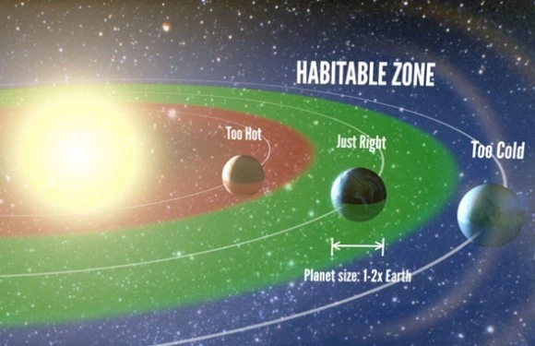
Habitable zones of the milky way

Slide 10
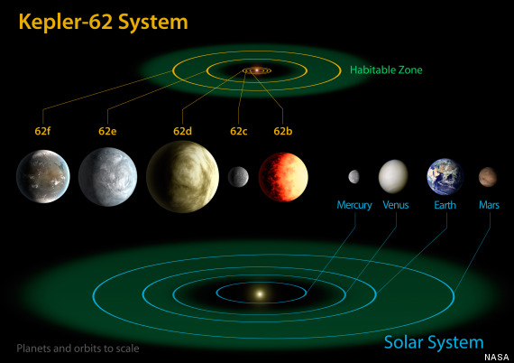
Kepler-62 is a star somewhat cooler and smaller than the Sun in the constellation Lyra, 1,200 light-years from Earth. It is located within the field of vision of the Kepler spacecraft, the satellite that NASA's Kepler Mission used to detect planets that may be transiting their stars. On April 18, 2013 it was announced that the star has five planets, two of which, Kepler-62e and Kepler-62f are within the star's habitable zone. The outermost, Kepler-62f, is likely a rocky planet. (https://en.wikipedia.org/wiki/Kepler-62)

Slide 11
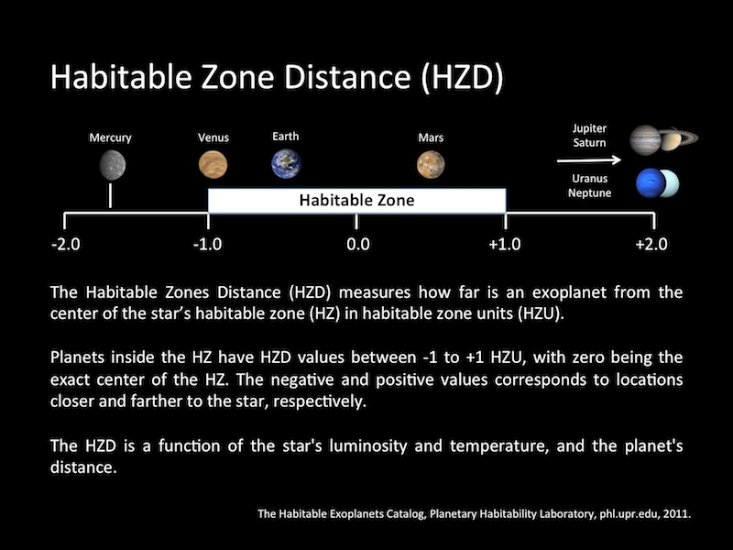

Slide 12
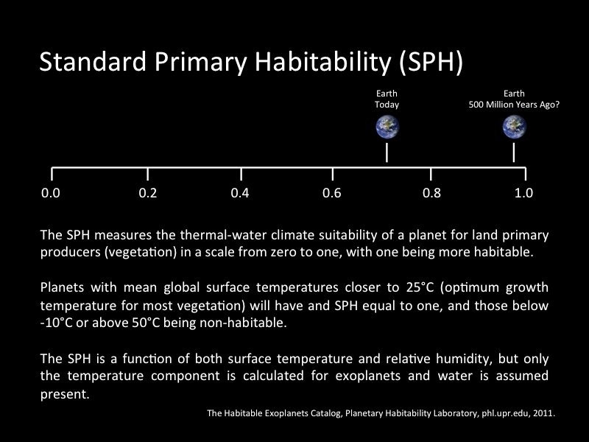

Slide 13
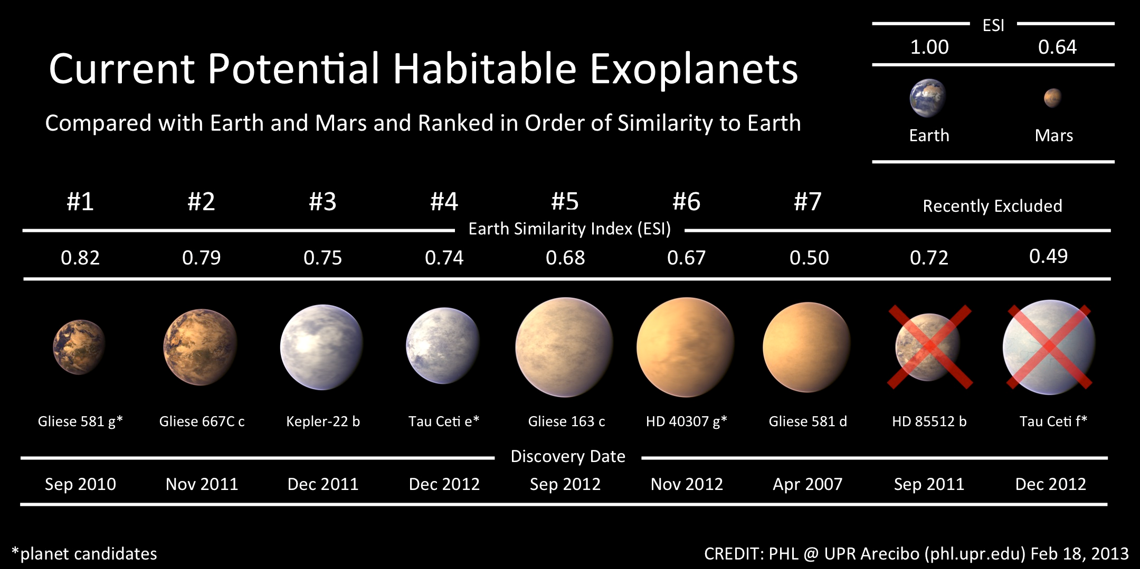
Discovery of Gliese 581c - https://www.youtube.com/watch?v=QbocejG0o2k

Slide 14
Views on the Origination of Life
Special creation
Life is so complex that it required a supernatural force to generate it.
This is the Christian, Moslem, and African traditionalist views.
The problem some scientists have for this view is that it is mystical and cannot be proved.
It does not obey the natural laws.

Slide 15
Colonisation theory (Theory of Panspermia)
Life might have arisen from some life forms that came from elsewhere in the universe.
It was suggested that life in the form of living spores could have been driven to the earth by the pressure of light from the star of another planetary system.
Other scientists, like Francis Crick and Leslie Orgel proposed that
the transport of life from elsewhere might have been directed by some intelligent forces.
The colonization theory can neither be proven nor reﬁtted since it begs the question as to the origin of life.
The colonization theory espouses the extra-terrestrial origin of life.

Slide 16
Panspermia Theory suggests that life seeds came from outer space and planets exchanged life. Panspermia literally means seeds everywhere.
Panspermia suggests that life could have existed on another planet and moved to Earth. Statistics have showed 7.5% of rocks from Mars reach Earth. The rocks would travel between less than 100 years to 16,000 years and more to get to earth.
Some of the proponents include Sales Gyon de Montlivant, who proposed life came from moon, H.E. Richter, who suggested life came from meteorites/comets, and Svante Arrhenius, who came up with Panspermia.

Slide 17
Evidence for Panspermia
Bacteria can survive harsh environment of space
a. Ultraviolet radiation
b. Protons bombardments
c. Cold
Evidence that meteorites contain life
Amino acids (left handed in helicity)
Bacteria
Carbon
Protected inside rocks
Bacteria can live for a long time in a sleeping state until awakened
Mars is safer than Earth (less bombardments and less gravity)
Mars not as hot as Earth in early development
Mars had have had oxygen back then when earth did not
Did Life on Earth come from Space? - https://www.youtube.com/watch?v=cUyLODoZiVM

Slide 18
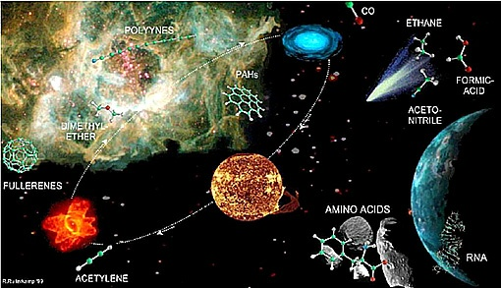

Slide 19
Spontaneous generation theory
This theory asserts that life arose abiogenically.
Aristotle (384-322 BC) had suggested that when soil, straw or refuse that was free of life was left for a period of time, living organisms could emerge from them spontaneously if condition were right.
Van Velmont (1577 - 1644), a Dutch Scientist supported it.
The ﬁrst blow to the spontaneous generation idea was from the work of Francesco Redi (1626-1697).
The invention of microscope by Anton van Leeuwenhoek in 1675 paved the way for the study of Spontaneous generation of microbial life.

Slide 20
Needham and Buffon - mutton broth is heated to boiling, it could still support the growth of microbes.
Lazzaro Spallanzani (1729-1799) detected loopholes in the experimental set-up of Needhan and Buffon.
Louis Pasteur (1822-1895) was the person who gave the last blow to the spontaneous generation idea.
He showed that air was a suspension of microbes that could infest sterile broths.

Slide 21
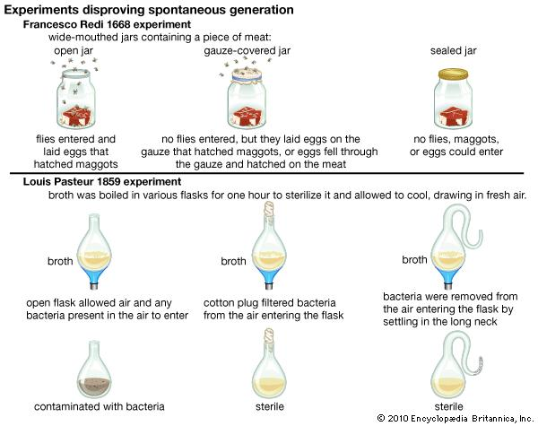

Slide 22
Long-term spontaneous generation
In the twentieth century, two prominent scientists; JBS Haldane, a British Biochemist and AL Oparin, a Russian Biochemist suggested that life once evolved from non-living matter.
In the period for the chemical evolution, raw materials present on the primitive earth were used to synthesize both monomers and macromolecules for living cells.
The raw materials were readily available together with the suitable energy sources.
The largest source of energy was sunlight.
Another source of energy was electrical discharges from lightning.

Slide 23
The major starting materials for prebiotic synthesis came from the atmosphere.
Simple molecules present in the primitive atmosphere included hydrogen, methane, water vapour, ammonia and probably hydrogen sulphide.
The earth crust contained metallic sulphide and mineral phosphates. It is also possible that the raw materials could have been transported to the earth by extraterrestrial bodies like meteors and comets.

Slide 24
The carbonaceous meteorites contain organic molecules like those contained in biological molecules, for example, alcohols, aldehydes, amines, amino acids, purines, pyrimidines, etc.
Some meteorites also contain clays.
Comets also could have served as good sources of carbon, hydrogen and nitrogen compounds on the primitive earth.
Comets are heavenly luminous bodies with gaseous tails.
Those comets, with irregular orbits could collide with the earth, depositing their contents on the earth.

Slide 25
Chemical and Biological evolution
Chemical evolution refers to the formation of complex organic molecules from simple molecules.
Biological evolution is the formation of a self-sustaining, self-replicating system from the complex organic molecules.
We can identify the following steps in chemical and biological evolution:
Formation of biologically important monomers like sugars, amino acids, organic bases etc from simple compounds like CH₄, NH₃, H₂O.
Polymerization of the monomers into biopolymers like proteins and nucleic acids.
Aggregation of biopolymers into prototypes of cells.
Development of some type of reproductive machinery to ensure that progeny cells possess all the metabolic potentials of the parent cell.

Slide 26
Prebiotic (Premordial) soup
The biologically important compounds formed, due to the absence of oxygen in the atmosphere were spared any oxidative alteration.
So these could persist and be washed by rain into the oceans for their concentrations to build up forming the prebiotic or primordial soup.
The Primordial Soup Theory suggest that life began in a pond or ocean as a result of the combination of chemicals from the atmosphere and some form of energy to make amino acids, the building blocks of proteins, which would then evolve into all the species. This is suppose to happen at least 3.8 billion to 3.55 billion years ago.
The Russian Chemist A.I. Oparin and English Geneticist J.B.S. Haldane first conceived of this idea. Both developed this theory independently in 1920.

Slide 27
In this theory, the basic building blocks of life came from simple molecule which formed in the atmosphere (w/o oxygen). This was then energized by lightning and the rain from the atmosphere created the "organic soup". The first organisms would have to be simple heterotrophs in order to survive by consuming other organisms for energy before means of photosynthesis. They would become autotrophs by mutation. Evidence now suggest the first organisms were autotrophs
Chemist Stanley Miller and physicist Harold Urey did a famous experiment in 1950 to test this theory. They mixed gases thought to be present on primitive earth:
Methane (CH4), Ammonia (NH3), Water (H2O), Hydrogen (H2), No Oxygen
They then electrically sparked the mixture to signify lightning. The results were amino acids, the building blocks of proteins. It was later discovered that other energies also can excite gases and produce all 20 amino acids:
Electricity, Ultraviolet light, Heat, Shock

Slide 28
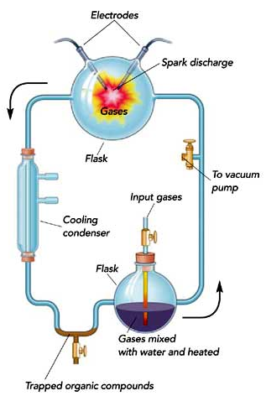
Primitive earth simulation experiment (by Stanley Miller)
Fig 1: Experimental set-up by Miller to prove the synthesis of some biologically useful molecules in the presence of molecules in the atmosphere and energy sources available.

Slide 29
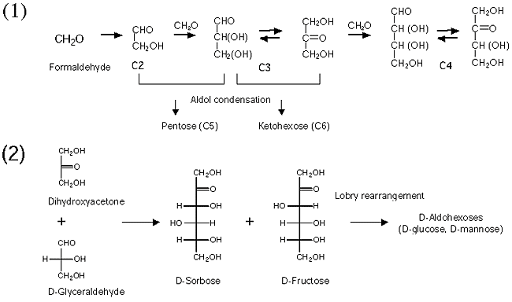
The prebiotic synthesis of monosaccharides (formose reaction)

Slide 30
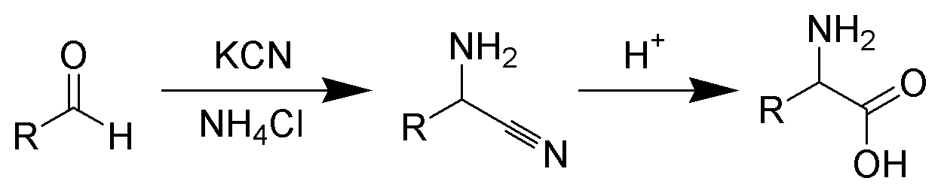
The prebiotic synthesis of amino acids (Strecker synthesis)
Amino acids could have been formed through the Strecker synthesis in which an aldehyde reacted with HCN.
The Strecker synthesis is made up of the following steps;
Ammonia reacts with an aldehyde to form an imine
The addition of a cyanide to the imine
Hydrolysis of the aminonitrile to give the corresponding amino acid.

Slide 31
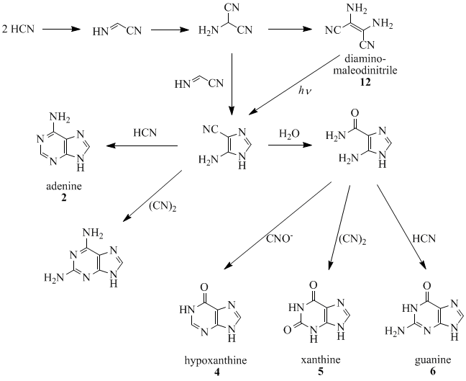
The prebiotic synthesis of nucleotide bases (polymerization of HCN)

Slide 32
The prebiotic synthesis of fatty acids
High temperature and high hydrogen pressures were required for the synthesis of fatty acids.
The problem with the suggested mode of fatty acid formation is that the elevated temperature for the synthesis could not have been attained in the primitive times over an extended period.

Slide 33
Why the primitive atmosphere was said to be reducing
There was little or no oxygen present, so there was no ozone layer to block the UV radiation from sunlight as occurs now.
The matter from which the earth was formed was mostly hydrogen, a good reductant.
Meteorites contain iron either as metallic Fe or Fe²⁺.
Carbon was also present as elemental carbon, carbides or hydrocarbons.

Slide 34
Polymerization and condensing agents
Polymerization is the coming together of several monomers to form more complex molecules.
Through such a process polypeptides, polynucleolides and polysaccharides could be formed.
If two molecules of glucose, for example, join together, the elements forming water should be removed from the two molecules.
How could this be achieved in a prebiotic soup which is predominantly made up of water?
Glucose + Glucose Disaccharide + H₂O

Slide 35
The forward reaction is a condensation reaction but the backward reaction is hydrolytic.
The condensation reaction would be thermodynamically favoured if the water formed by the condensation can be removed by evaporation or by the use of condensing agents.
In the use of such condensing agents, there would be two advantages.
There is the formation of a high-energy intermediate, thereby shifting the equilibrium in favour of the condensation, allowing the reaction to take place in the aqueous medium.
Secondly, the intermediate formed is usually more reactive than the unmodiﬁed monomers.

Slide 36
Therefore, the forward condensation reaction was coupled to uptake or the removed water by condensing agent.
Such condensing agents typically had carbon atom linked by energetic double bonds to two nitrogen atoms (-N=C=N-) e.g. carbodiimide of the general formula, R-N=C=N-R.
Other condensing agents in the prebiotic soup could have been cyanogen (N≡C-C≡N), cyanamide (N≡CNH₂), cyanoacetylene (N≡C-C≡CH) and diaminomaleonitrile.
The free energy of hydration of the condensing agent drives the reaction.
Polyphosphates like ATP could also be used as condensing agents.
These polyphosphates were also energy sources used by living organisms.

Slide 37
Polypeptides and polynucleotides
Various studies have gone into how two important biopolymers, polynucleotides and proteins were formed.
The polymerization process per se might not have been the problem but the real problem was the competition by water molecules in the coupling process.
One way of lowering the amount of water in the vicinity was through evaporation to concentrate the reactants while removing H₂O from the product
(what happens to other biological monomers like HCN, formaldehyde, NH_{3,} which are themselves volatile?)

Slide 38
Another way of achieving polymerization was heating to dryness.
Critics argued that those high temperatures could not have existed over extended region of the earth’s surface.
A prolonged exposure to the high temperatures could cause the decomposition of the peptides formed.
One other effective way for concentrating prebiological molecules was the adsorption of molecules on the surface of minerals like micahs, clays (made up of silicates attached to cations) and kaolin.
The abundance of positive and negative charges on clays, apart from binding charged molecules, also enabled them serve as primitive catalytic centres for reactions.

Slide 39
There could be both non-instructed and template-directed synthesis of polypeptides and polynucleotides.
The non-instructed synthesis of the two polymers could be achieved by dry heating or by the addition of a condensing agent such as a polyphosphate or cyanamide.
The template-directed synthesis of polypeptides can be divided into two categories:
The synthesis of activated amino acids on a clay ‘template’ where no sequence preference is shown.
Synthesis that is directed by a nucleic acid template.
Template-directed polynucleotide synthesis could use imidazole-activated monomers in the presence of divalent cations.

Slide 40
Which of the two is more primitive; protein or nucleic acids?

Slide 41
Proteins have structural and catalytic functions while the nucleic acids are informational molecules.
Nucleotides also serve as coenzymes, aiding catalytic action of enzymes (e.g. ribozyme).
A more plausible reasoning is that proteins and nucleic acids evolved in parallel.
The ability of polynucleotide to replicate could be coupled to the ability of polypeptide to act a catalyst.
The polynucleotide could specify polypeptide by a process of translation, while the polypeptide in turn, would catalyse the replication of the polynucleotide and possibly the translation process.

Slide 42
The discovery of ribozyme (RNA enzyme) has added another dimension.
It is now being argued that ribozyme originated before translation systems.
It was after translation to form protein enzymes that the majority of ribozymes were replaced by more efficient protein enzymes.

Slide 43
Formation of cells and membranes
The simplest structure that shows the evidence of life is a cell.
A cell is a compartment, and should have a membrane to separate it from its surroundings so that it is not diluted out of existence.
Oparin and Fox independent investigations
Oparin suggested that the ﬁrst cells emerged when a boundary or membrane formed around some molecules possessing catalytic activity, most probably proteins.
He called his ‘cells’ protobionts.
The protobionts were formed through a process of coacervation.

Slide 44
This phenomenon takes place in an aqueous solution of highly hydrated polymers.
It involves the spontaneous separation of one phase of aqueous solution of polymers into two phases;
one phase having higher polymer concentration,
and the other phase with low polymer concentration.
The droplets could interact with their aqueous environment to acquire other compounds to make the droplets grow.
Some of the resulting progeny droplets which retain catalyst-substrate nature of parent droplet, could grow to give another generation of droplet.

Slide 45
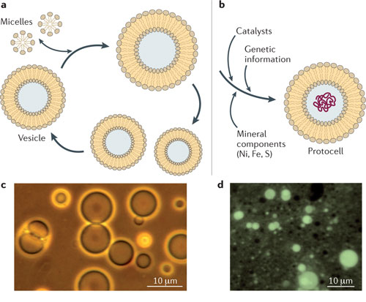

Slide 46
The shortcoming of Oparin’s coacervate droplets is that they were formed from materials such as gum arabic, histone and albumin which had already been formed by living systems.
Fox’s thermal proteinoids were another type of micro-spheroidal aggregates.
Under suitable conditions, the proteinoids form microspheres several micrometres in diameter which grow and eventually bud.
These microspheres have a two-layer membrane similar to that of bacteria.
The problem with the membranes of Fox’s proteinoids was that they were too leaky.

Slide 47
Development of Metabolic Pathways
Competition for nutrients led to the development of metabolic pathways.
The polymerization reactions evolved were dependent on the environment to supply the necessary monomeric units and the energy-rich compounds such as ATP or polyphosphates that powered these reactions.
As the essential components in the prebiotic soup became scarce, organisms developed the enzymatic systems that could syntheses these substances from simpler but more abundant precursors.
As a result, energy-producing metabolic pathways arose.
Such pathways consumed other pre-existing energy-rich substances.

Slide 48
As these became increasingly scarce, the photosynthetic system was evolved to take advantage of the sun whose energy supply was inexhaustible.
In photosynthesis, reducing agents such as H₂S was initially used, until this reductant was exhausted.
This led to the reﬁnement of the photosynthetic apparatus to utilize a more ubiquitous reducing agent, H₂O.
But the use of water brought in its trail, the production of highly reactive O₂, as a by-product.
To circumvent any oxidative damage due to the accumulation of O₂, a much more efficient form of energy metabolism that used the newly available O₂ as an oxidizing agent was adopted.

Slide 49
Oxygen was only a minor component of the atmosphere until when photosynthetic organisms began to produce oxygen from the oxidation of water.
It was after this time that the ozone layer was formed to serve as a shield against UV rays from the sun.
The shield was not present on the primitive earth when there was little atmospheric oxygen.

Slide 50
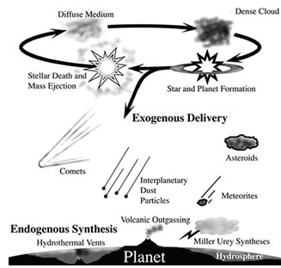
Summary

Slide 51
GEMP ACCESS COURSE: BIOLOGICAL CHEMISTRY
Lecturer: Christopher Larbie, PhD
Lecture 2:
Elemental Composition of Cells

Slide 52
STUDY OBJECTIVES
In this lecture, we will go through
How elements were formed: the origin of elements
The list of elements that make up living cells
Why some elements were incorporated in cells while others were excluded
Why carbon forms so many compounds.

Slide 53
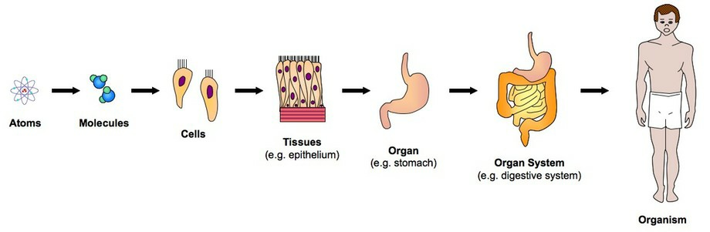
Introduction
All living cells and organisms are made up of elements which are intricately organized to form recognizable structures, characteristic of the cells or organisms.
Cells are viewed as the building blocks of cells but in biochemistry, the atom/elements are the building blocks

Slide 54
Origin of Elements
Elements are believed to have been formed through the following processes
Big bang
Fusion reactions in the stars
Artiﬁcial synthesis
Video: Origin of the Universe 101 by the National Geographic Channel
Forms naturally occurring elements
https://www.youtube.com/watch?v=HdPzOWlLrbE

Slide 55
The Big Bang Theory
Explosion of an infinitely hot and dense ball of primordial matter which led to the formation of Hydrogen and Helium.
Gravitational forces brought together clouds of gas that eventually collapsed into vast galaxies made up of billions of stars.
All the elements other than hydrogen and helium were formed in the centre of these stars, and these elements were released upon the explosion of some of these stars.

Slide 56
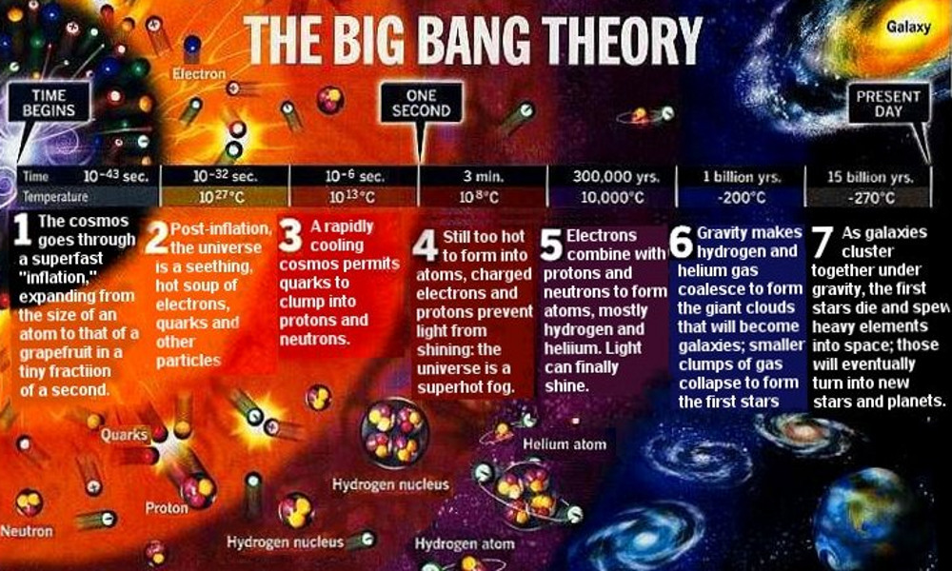

Slide 57
Fusion reactions in the star
The very high temperatures and concentrations of reactants required for the formation of other elements can be achieved in the core of stars.
The very high temperatures are required to overcome the electrostatic repulsion that exists between the positively charged nuclei, which must fuse.
The fusion reactions radiate heat and light, so that a star is formed from the cloud of gas.
At some point an enormous amount of energy is released that leads to the explosion of the star

Slide 58
Most visible stars emit light created by the burning of hydrogen to form helium.
The hydrogen that fuels most stars is eventually used up: in smaller stars, the hydrogen gets exhausted much more rapidly in large stars like the sun.
Upon the exhaustion of hydrogen, the core temperature of the star reduces, and the star begins to collapse.
The heat released by the collapse causes the core temperature to rise to new levels until the ignition temperature for helium is reached.

Slide 59
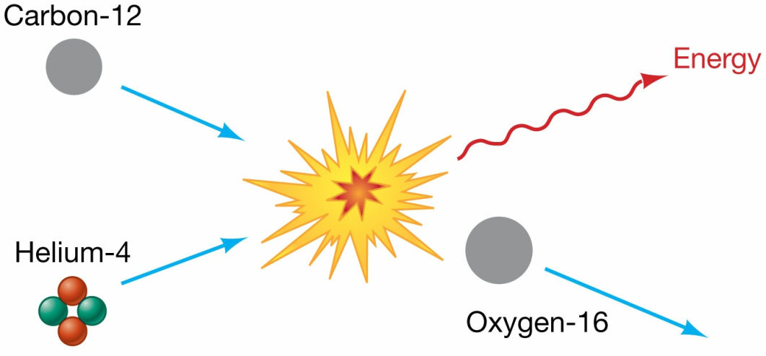
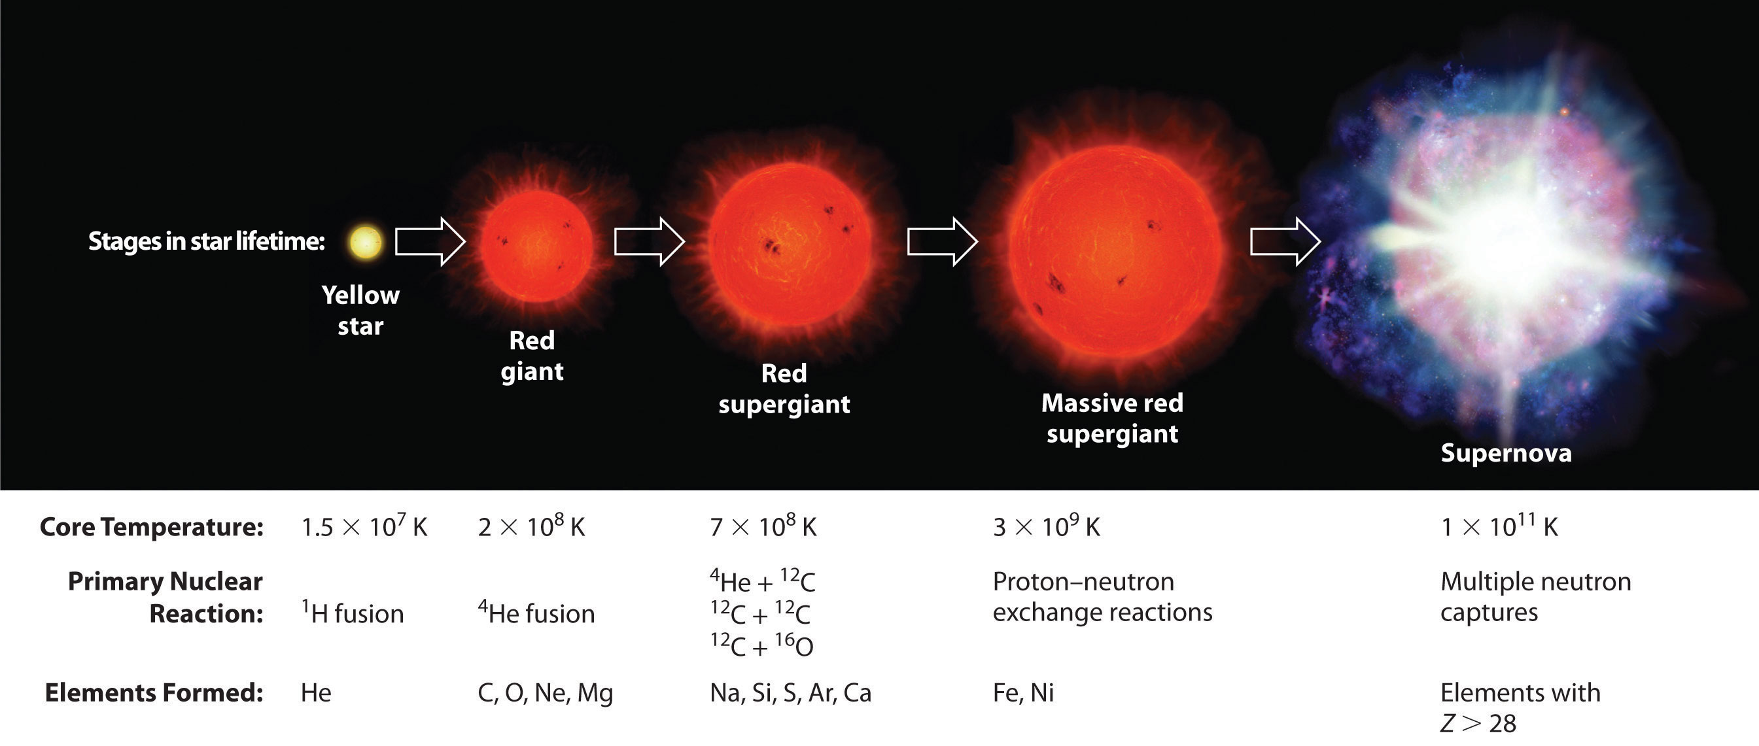
Two helium nuclei fuse to form beryllium (⁸Be) nucleus which is unstable, and so does not survive for any length of time.
Another helium nucleus can fuse with Be to form Carbon (¹²C).
Another fusion with helium forms oxygen (¹⁶O).

Slide 60
The largest atom that can form from the nuclear fusion reactions is iron.
Those atoms that are larger than Fe are formed when the neutrons resulting from the explosion of a star are captured by the nuclei of Fe atoms.
The even-numbered elements are far more abundant than those with odd number mass numbers.
The relative abundance of the elements is dependent on the mechanism of formation and the stability of the nuclei formed.

Slide 61
Laboratory synthesis of elements
New elements with atomic number beyond 92 (the transuranium elements) have been synthesized this way.
In the process, high energy particles produced in cyclotrons are required to use with target nuclei.
For example, Seaborg formed the synthetic element, Californium, by using a cyclotron to accelerate the nuclei of C-12 to fuse with Curium (₉₆Cm). (read more at https://en.wikipedia.org/wiki/Californium)

Slide 62
Elements utilized to form cells
At present, there are over 117 elements, but less than a third of these elements are found in cells by natural selection.
The percentage of atoms in the earth
The percentage of carbon is just about 0.10
Oxygen (48.86%)
Iron (18.84%)
Silicon (13.96%)
Magnesium (12.42%)

Slide 63
Furthermore, there is similarity in the concentration of the main ions in seawater and that of blood plasma: such ions as Cu2+, Mg2+, Ca2+, Na+, K+, etc.
Almost every group on the periodic table has its representative in living cells (chemical democracy?)
Major or Bulk elements which are carbon, hydrogen, oxygen, nitrogen, phosphorus and sulphur (CHONPS) – found in organic compounds of the cell.
Minor or Trace: Na, K, Mg, Ca, B, V, Mn, Fe, Co, Ni, Cu, Zn, Si, Se, Cl, Br and Cr – found in the fluids that bathe the cell.

Slide 64
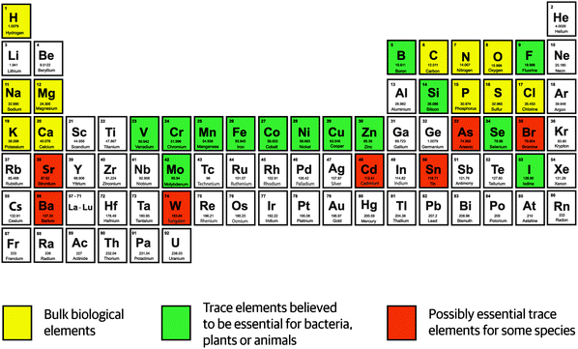

Slide 65
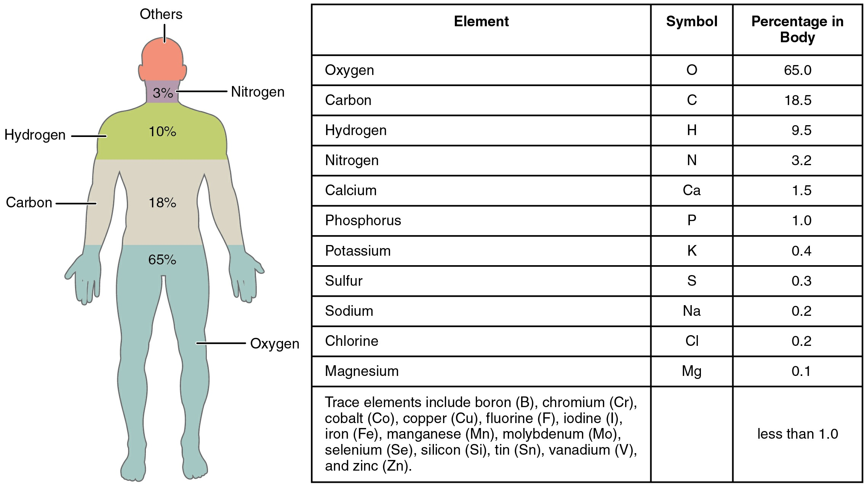

Slide 66
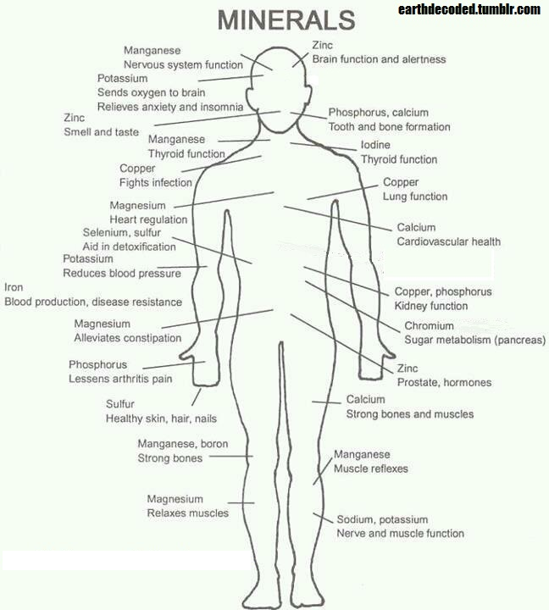

Slide 67
Striking features of the major elements
Majority are p-block elements
They are able to form covalent bonds
They are non-metals
They have smaller atomic sizes/numbers
They are neither too reactive nor inert.

Slide 68
Why is carbon so unique in its ability to form many compounds?
Carbon has got an ideal size, neither too small nor too big and can form stable covalent bonds
Carbon is tetravalent
It has the power of catenation
Carbon is also able to form multiple bonds, either with itself or with other atoms.

Slide 69
Other elements with the capacity to make three or more bonds
Silicon
Belongs to group IVA, thus tetravalent
Has a larger atomic size, hence, Si – Si bonds (rare) are weak because two Silicon atoms cannot approach enough to overlap effectively
Si-O bonds are so stable; chains of alternating Si and O atoms are essentially inert.
Even though silicon is about 140 times more abundant than carbon in the earth crust, carbon has been preferentially incorporated in living cells.

Slide 70
Nitrogen
It has five valence electrons when it forms N-N bond, hence, the bond energy will be low relative to that of C-C.
When the N-N bond is formed, there remains a lone pair of electrons on the atoms.
The repulsion between the lone pairs on the bonded nitrogen atoms will markedly reduce the bond energy of N-N bond.
Therefore, we expect extended chains of nitrogen atoms to be very unstable.
Boron
It has three valence electrons.
Unlike nitrogen, it will form electron deficient compounds
This will tend to limit the stability of boron compounds.

Slide 71
Reasons why other elements were not incorporated
Artiﬁcial nature of some elements
Inert nature of some elements
Toxic nature of some elements
Radioactivity of some elements

Slide 72
NB
Even though some elements are non-essential to life, they may be valuable with regard to the quality of life.
Lithium compounds like Li₂CO₃ is for the treatment of schizophrenic conditions.
Platinum and gold complexes are anticancer and anti-arthritis preparations respectively.
Kaolin which contains aluminium has anti-diarrhoeal properties.

